Slide 1
Predicting Breast Cancer Diagnosis
Prepared by: Faraz Ahmad

Slide 2
Overview
Breast Cancer is contributing as most common cancers and second leading causes of cancer death among women. However, it can be cured if caught at early stages but that requires rapid and accurate diagnosis.
The objective of this project is to develop a predictive model with the help of a Classification algorithm, k-Nearest Neighbour algorithm (kNN) that can classify cancerous tumor as benign or malignant with high accuracy and better performance. This will help pathologists to take accurate and timely decisions regarding this disease
To achieve this task, a Classification algorithm will be used on a multivariate data set of Breast Cancer Wisconsin (Original) obtained from UCI Machine Learning repository .This entire technique will be developed in R using RStudio.
The dataset consists of 699 patients with a total of 11 different variables. These variables will be used to create model that predict diagnosis as benign or malignant of a particular patient.
1. Sample code number: ID number
2. Clump Thickness
3. Uniformity of Cell Size
4. Uniformity of Cell Shape
5. Marginal Adhesion
6. Single Epithelial Cell Size
7. Bare Nuclei
8. Bland Chromatin
9. Normal Nucleoli
10. Mitoses
11. Class: (2 for benign, 4 for malignant)

Slide 3
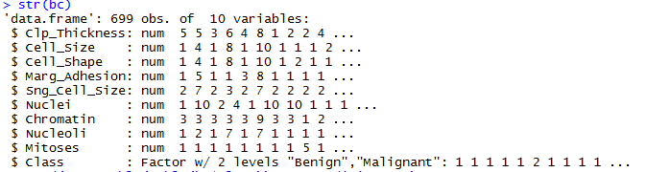
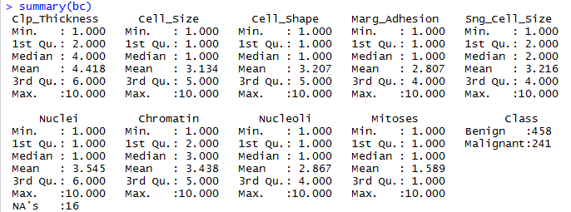

Data Analysis
The dataset consists of nine features, each of which represented as an integer between 1 and 10. The 458 samples of the dataset belong to benign class and other 241 are of malignant class.
After downloading dataset, headers were added with the help of R language in RStudio. Then ID attribute was removed as it was redundant for our experiment. The 16 records (Nuclei attribute) that have missing data were also removed. Then all nine features have been converted to numeric data type. The data has already been considered as normalized since all features are in range of 1-10.

Slide 4
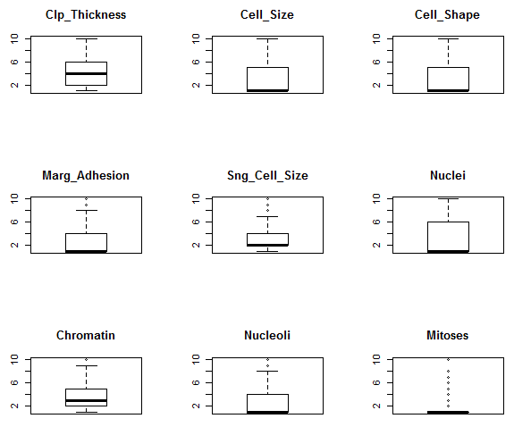
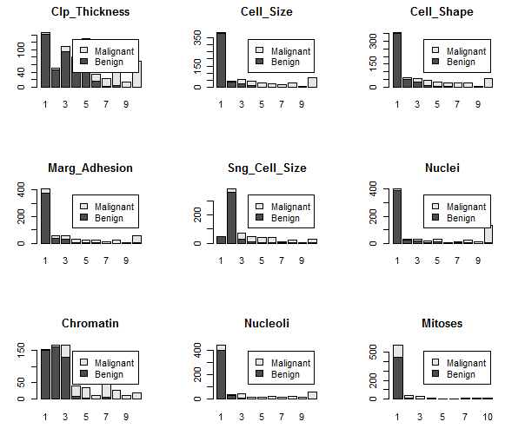
Data Visualization
Box and Whisker plots of input attributes shows that data is skewed.
Due to discrete data, bar plots used to observe the interaction of distribution of each attribute and how they breakdown by class value. It shows how the benign values clustered at the left (smaller values) of each distribution and malignant values are all over the place.

Slide 5
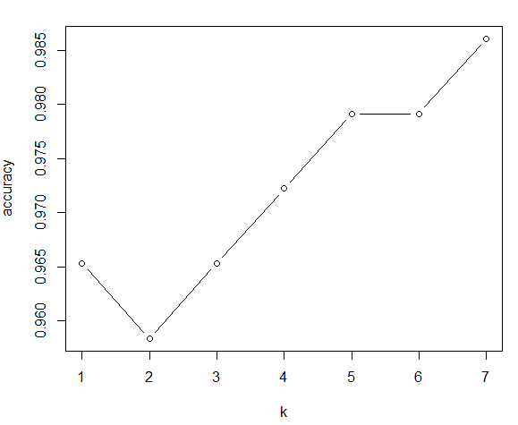

Initial Result
Binary classification technique was used for this experiment with the help of k-nearest neighbors (kNN) algorithm. It is the simplest and fastest among all other algorithms. Since we have low dimensionality, it is suitable for our predictive model project.
After data clean up, we shuffled our dataset and keep the same the ratio of Class in training (0.80) and test (0.20) datasets.
Then we build the classifier by setting k=1 to 7 and then applied the knn() function with training dataset.
The knn function takes arguments as the training data, test data, train labels and the amount of neighbors to find with this algorithm.
The highest accuracy achieved was 0.986 with k=7 which can be verified in the plot graph as shown.
To evaluate the model prediction, we applied the CrossTable function to understand the relationship between test data and our newly created model.

Slide 6
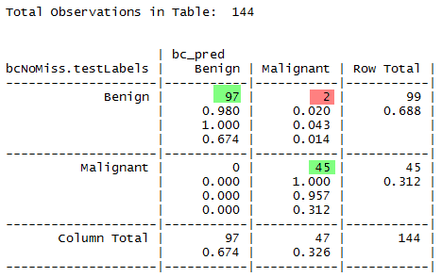

Initial Results
CrossTable:
There are 2 cases of FP - False Positive where Benign is appearing as Malignant.
Accuracy: TN + TP / total observation (97+45/144) = 98.6
Precision (When it predicts yes, how often is it correct): TP/Predicted Yes (45/47 = 95.74)
Misclassification Rate: Overall, how often is it wrong?
FP+FN)/total = (2+0)/144 = 0.011388
Specificity: When it's actually no, how often does it predict no? TN/actual no = 97/99 = 0.9797
Problem(s) Identified:
How to reduce or eliminate incorrect result (FP=2).
With regards to missing value, how to take care such records since there could be a cases where patient has missing data, we won’t able to evaluate thru our model.
To Finish the Project:
How to improve accuracy by compare with other algorithms.
Improve current result with further tuning kNN with 10 fold.
Code can be download from Githib:
https://github.com/farazahma/CKME136-Capstone/tree/master/Initial-Results-and-the-Code

